Slide 1
Project Presentation
Company: Gray Corporates
Name: Ritik Malviya
Internship Duration: 6 Months
Role: Data Analyst

Slide 2
Patient Data Analysis & Power BI Dashboard
1. Project Allocation and Submission Date
Project Allocation Date: 15/03/2025
Project Submission Date:

Slide 3
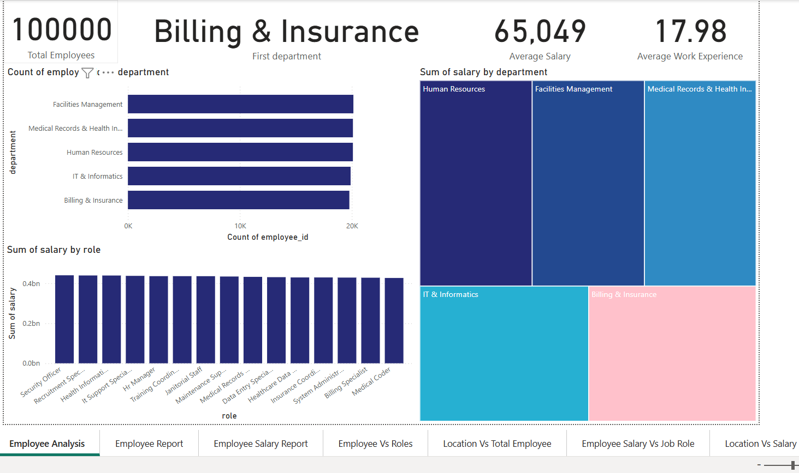

Slide 4
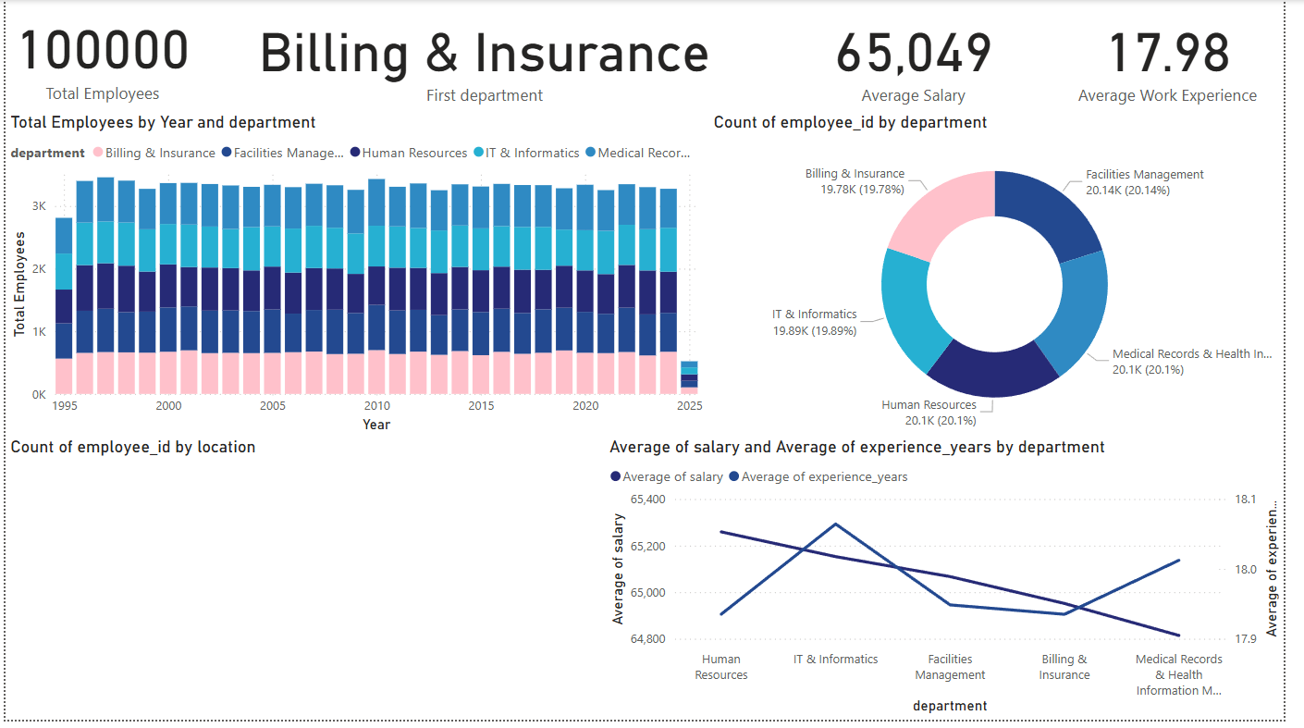

Slide 5
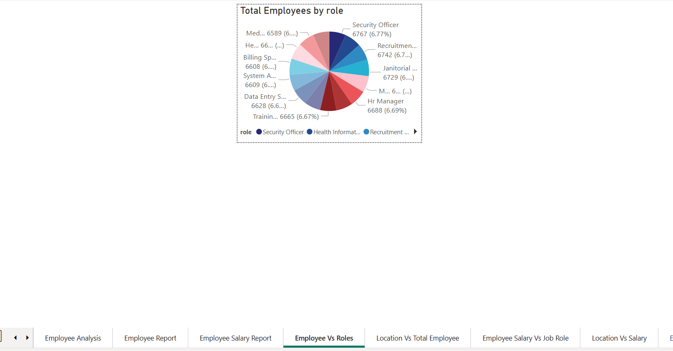

Slide 6
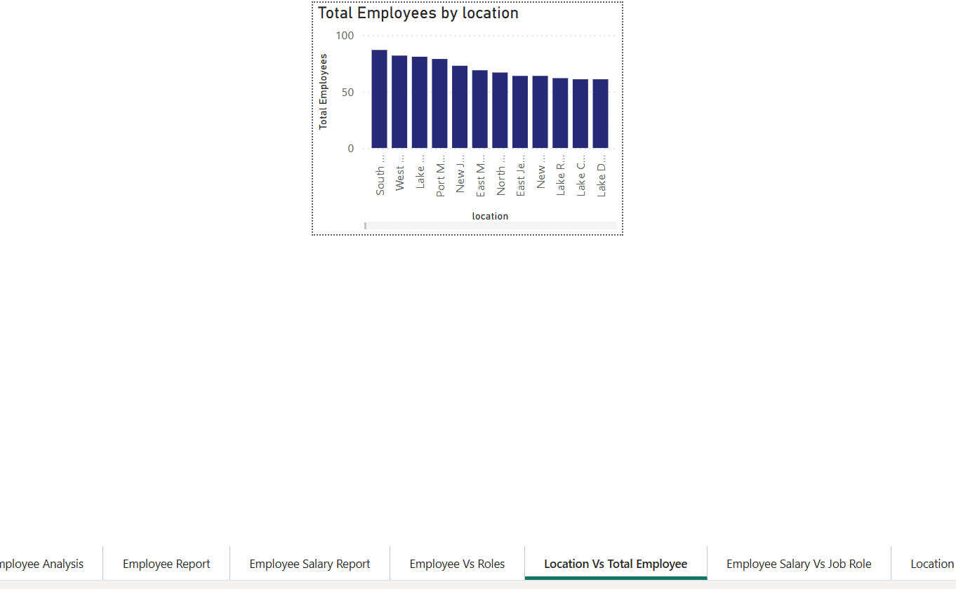

Slide 7
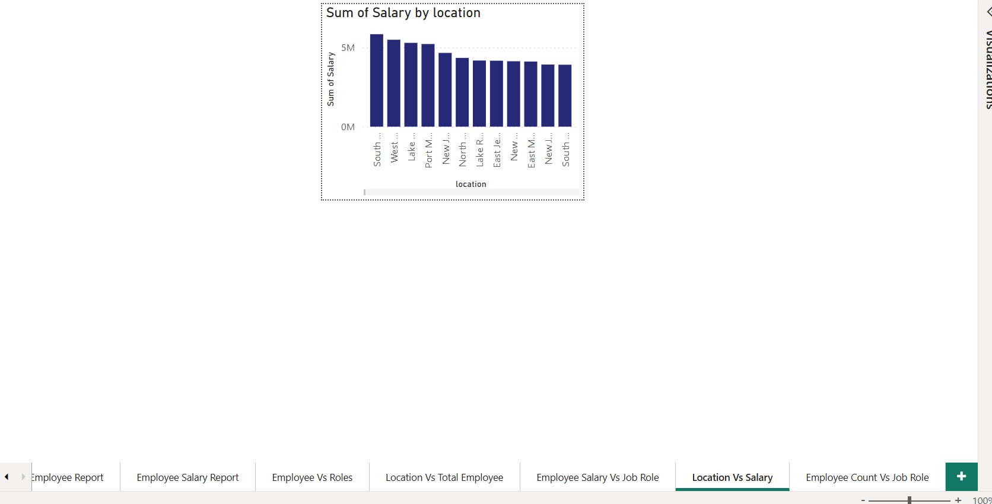

Slide 8
